Slide 1

AWS DATA ANALYTICS

Slide 2
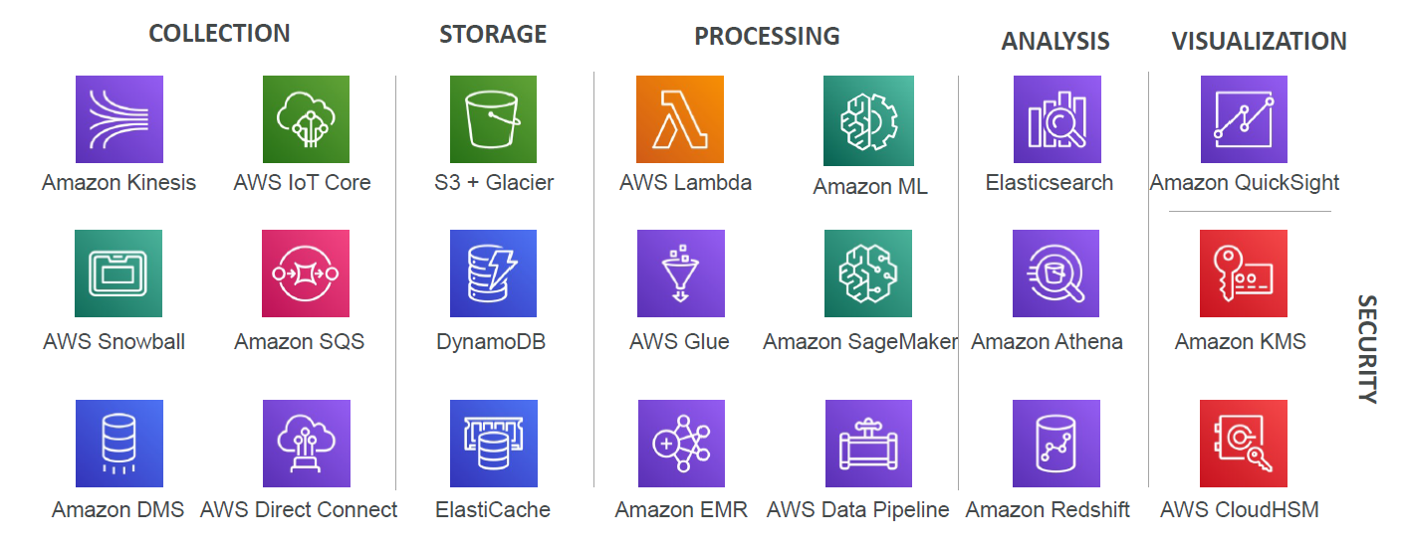

Slide 3

AMAZON S3 BUCKETS
Amazon S3 allows people to store objects (files) in “buckets”
Buckets must have a globally unique name
Buckets are defined at the region level
Naming convention
No uppercase
No underscore
3 63 characters long
Not an IP
Must start with lowercase letter or number

Slide 4
AWS S3 Overview -Objects
Objects (files) have a Key. The key is the FULL path:
my_bucket my_file.txt
my_bucket my_folder1/ another_folder my_file.txt
There’s no concept of “directories” within buckets
(although the UI will trick you to think
Just keys with very long names that contain slashes (“/”)
Object Values are the content of the body:
Max Size is 5TB
If uploading more than 5GB, must use “multi part upload”
Metadata (list of text key / value pairs system or user metadata)
Tags (Unicode key / value pair up to 10) useful for security / lifecycle
Version ID (if versioning is enabled)

Slide 5
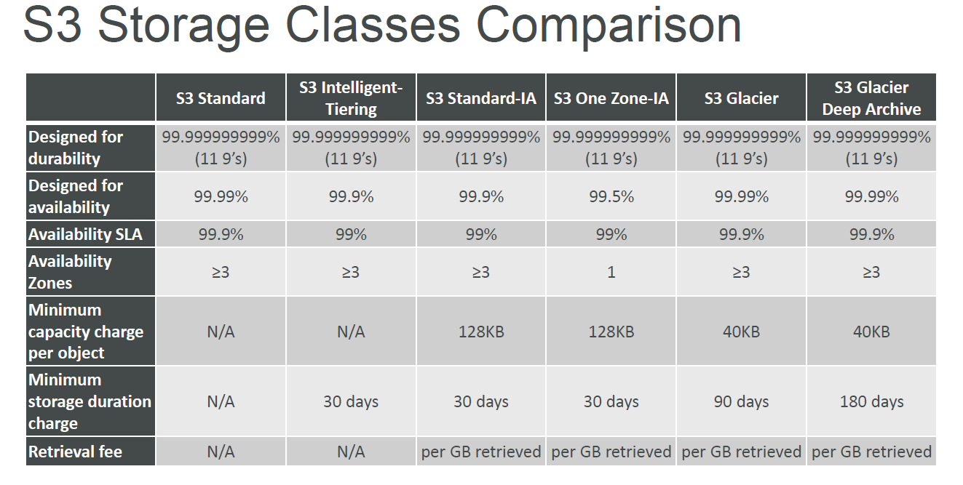

Slide 6
IAM

Slide 7
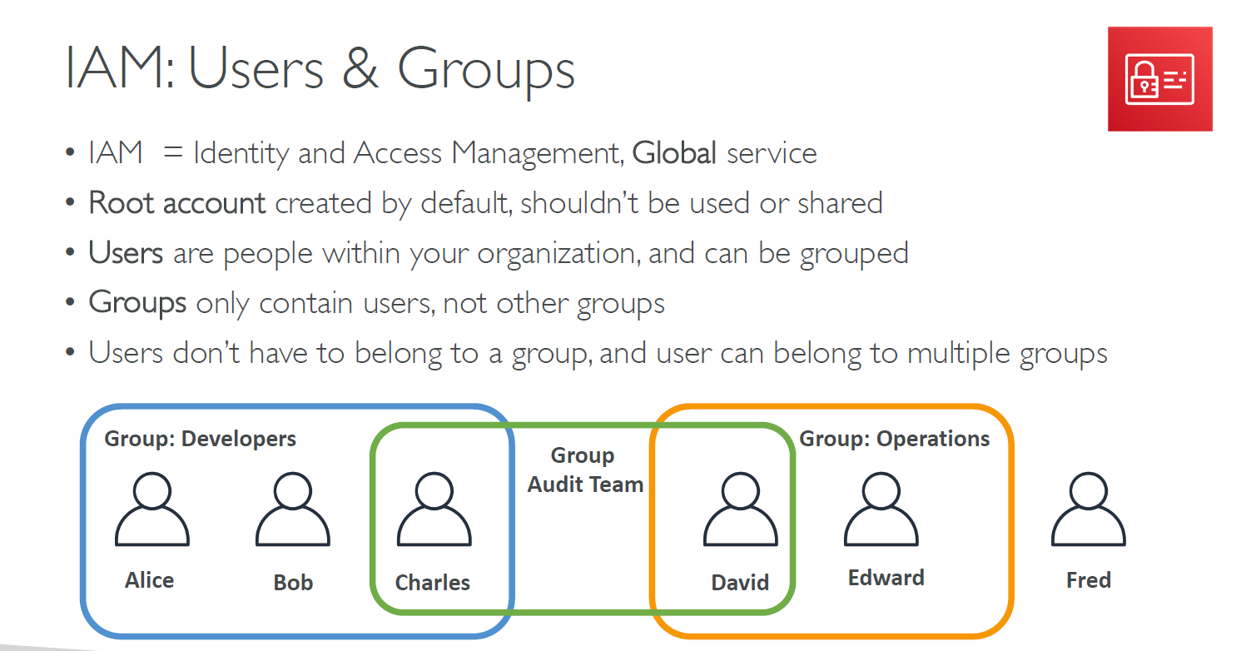

Slide 8
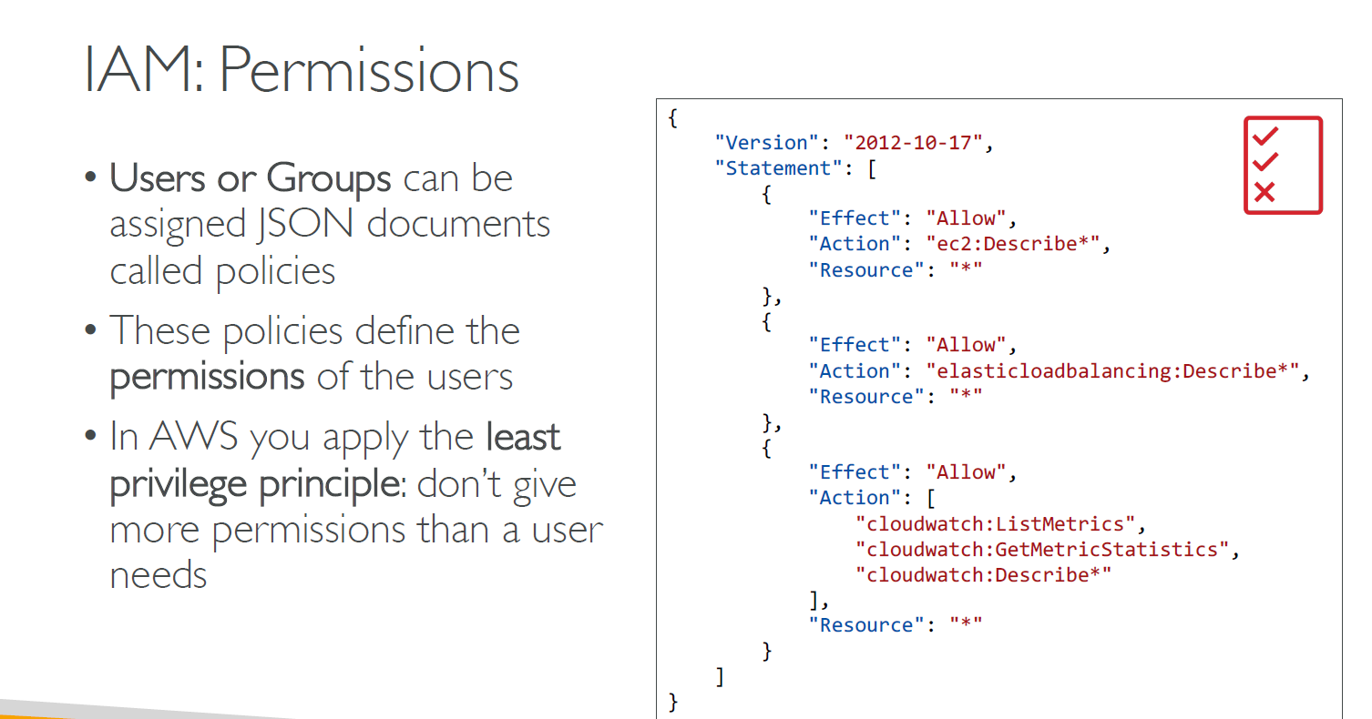

Slide 9
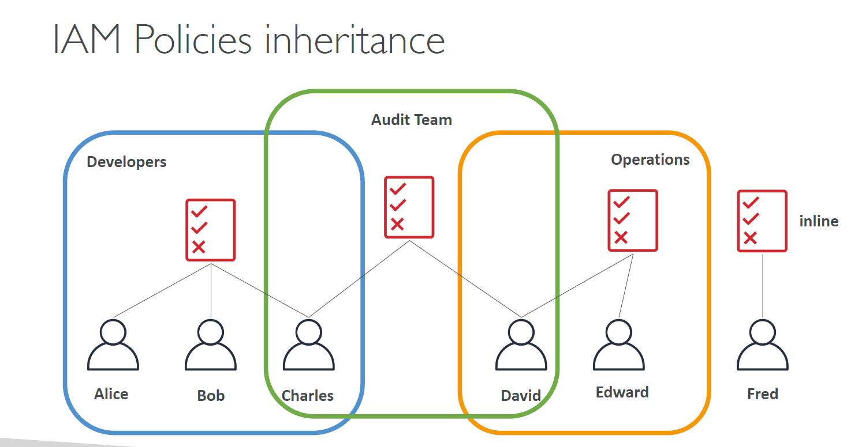

Slide 10
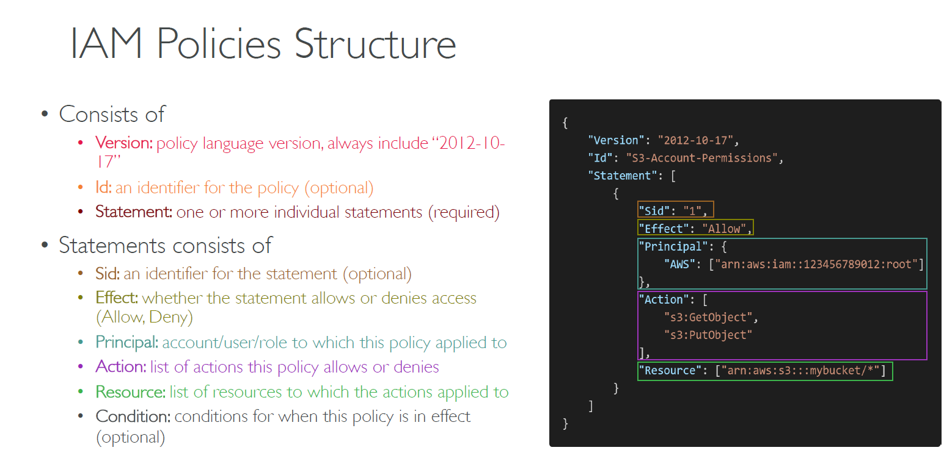

Slide 11
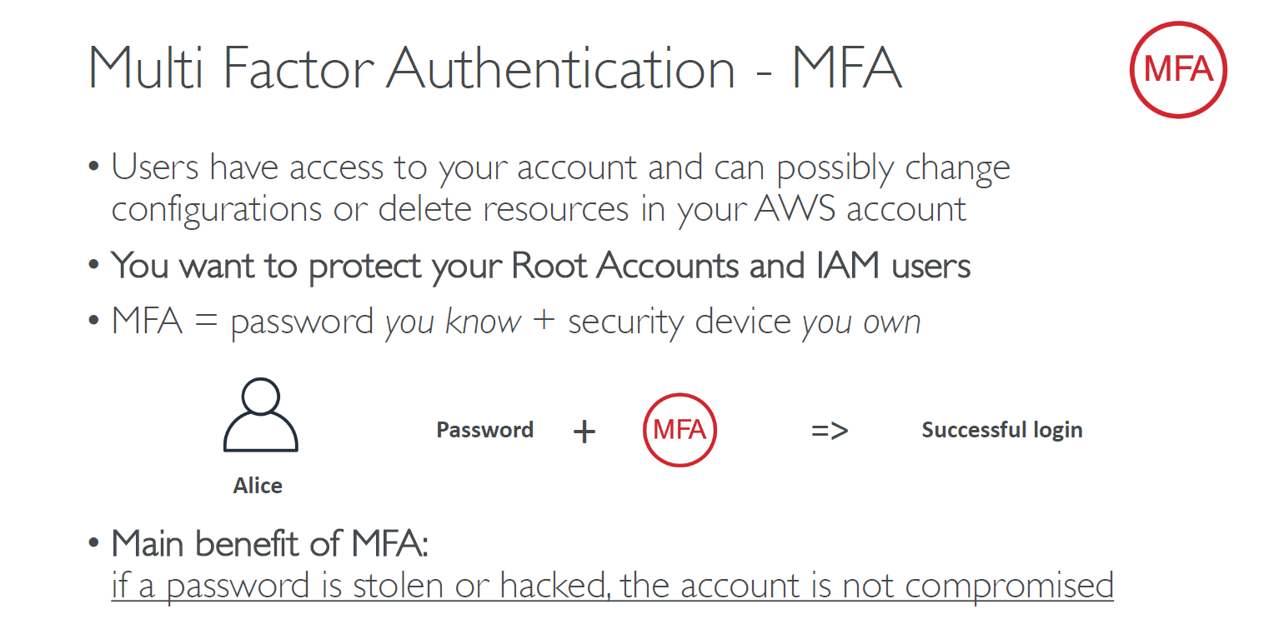

Slide 12
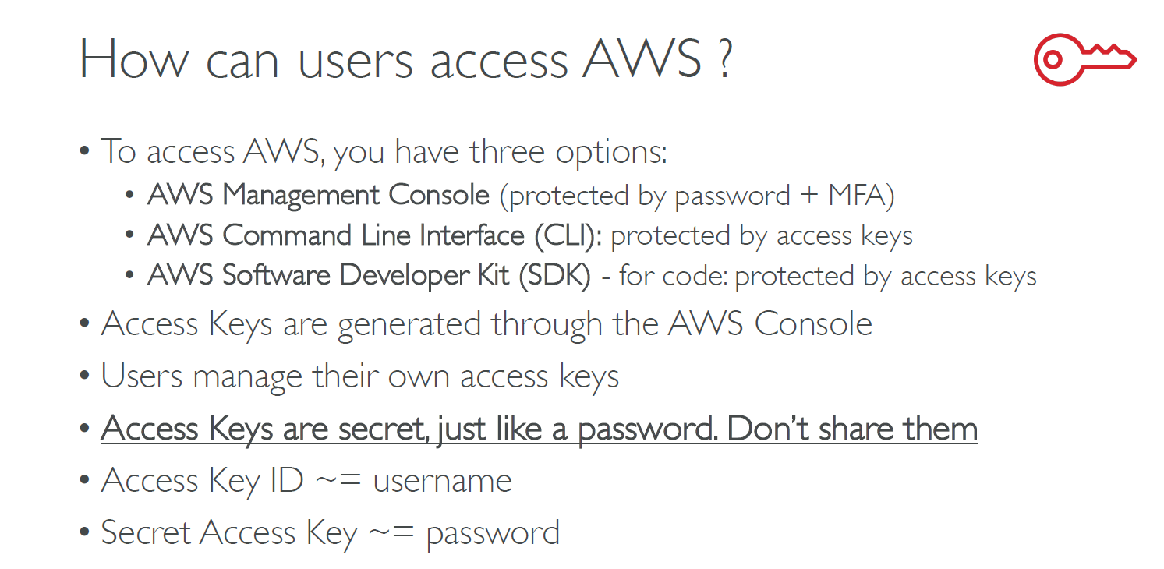

Slide 13
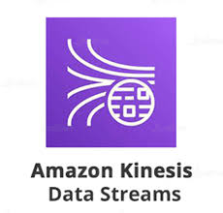
AWS Kinesis Overview

Slide 14
AWS Kinesis Overview
Kinesis is a managed alternative to Apache Kafka
Great for application logs, metrics, IoT, clickstreams
Great for “real time” big data
Great for streaming processing frameworks (Spark, NiFi , etc)
Data is automatically replicated synchronously to 3 AZ
Kinesis Streams: low latency streaming ingest at scale
Kinesis Analytics: perform real time analytics on streams using SQL
Kinesis Firehose: load streams into S3, Redshift, ElasticSearch & Splunk

Slide 15
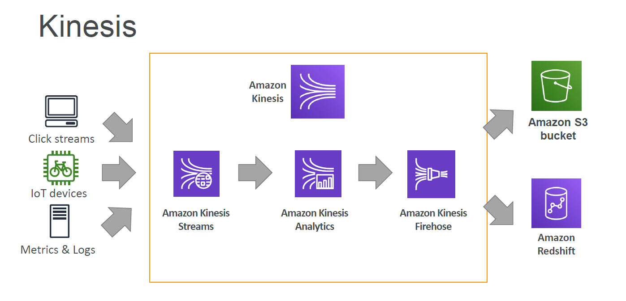

Slide 16
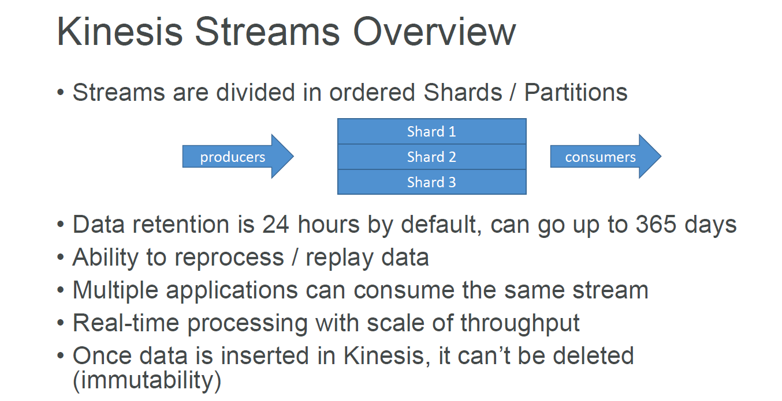

Slide 17
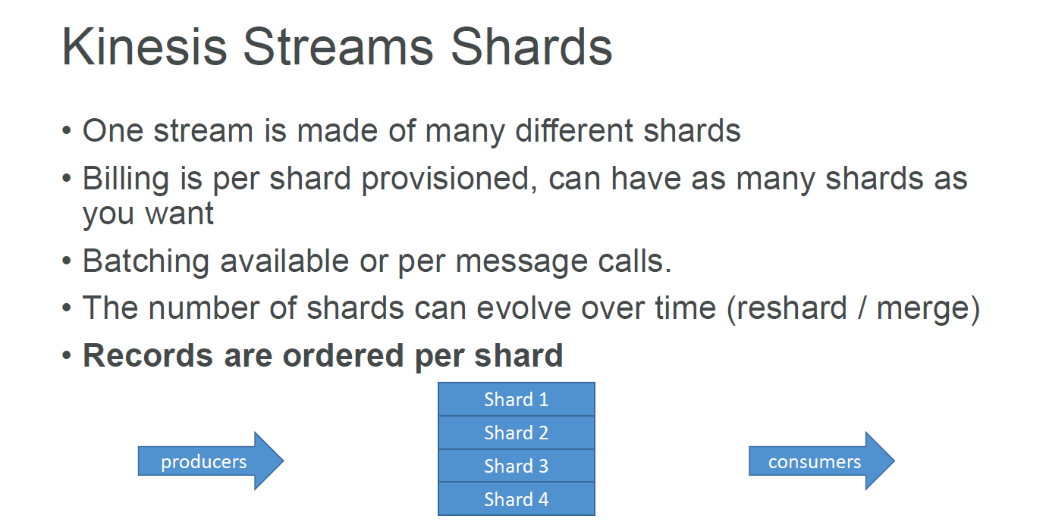

Slide 18
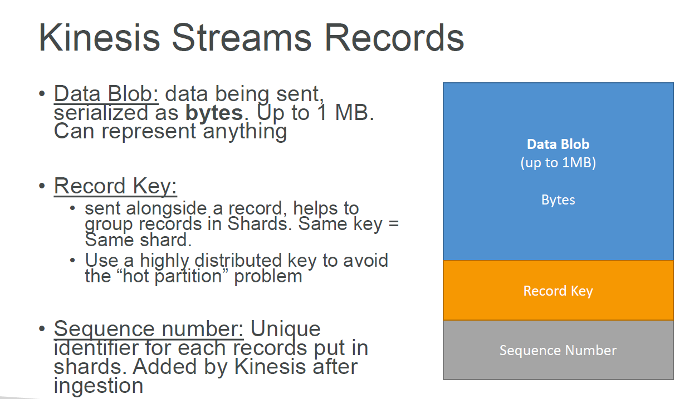

Slide 19
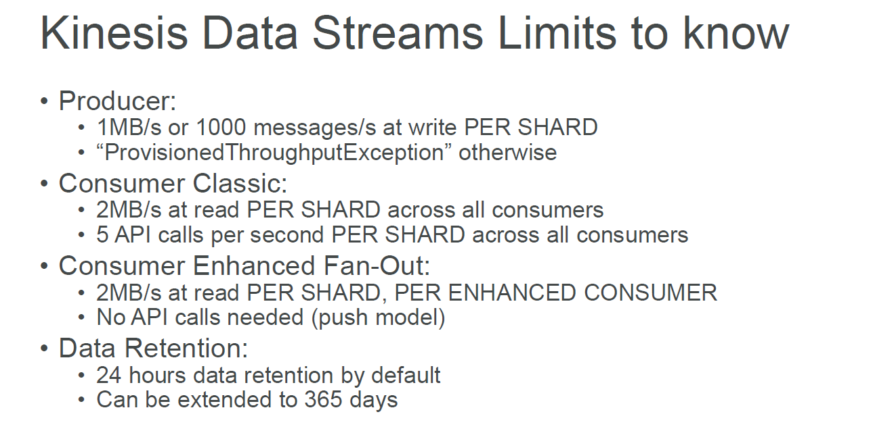

Slide 20
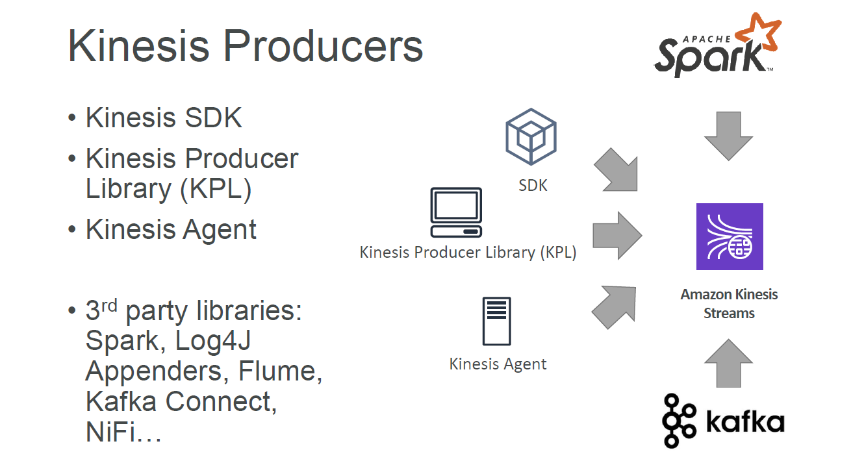

Slide 21
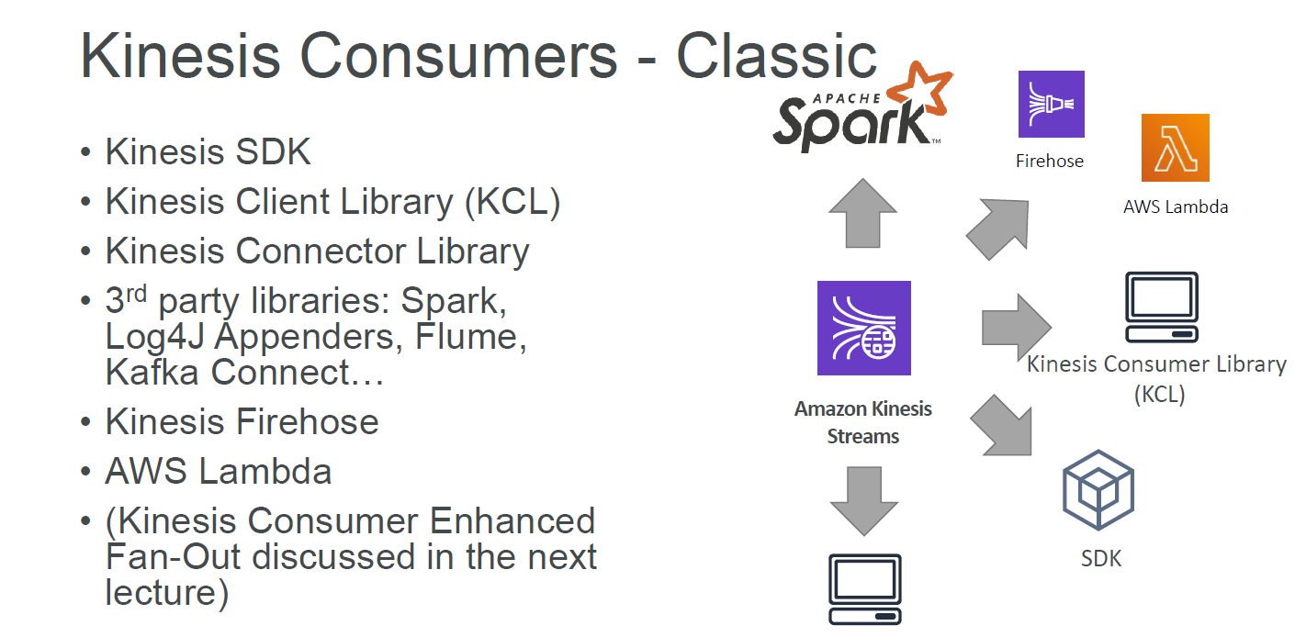

Slide 22
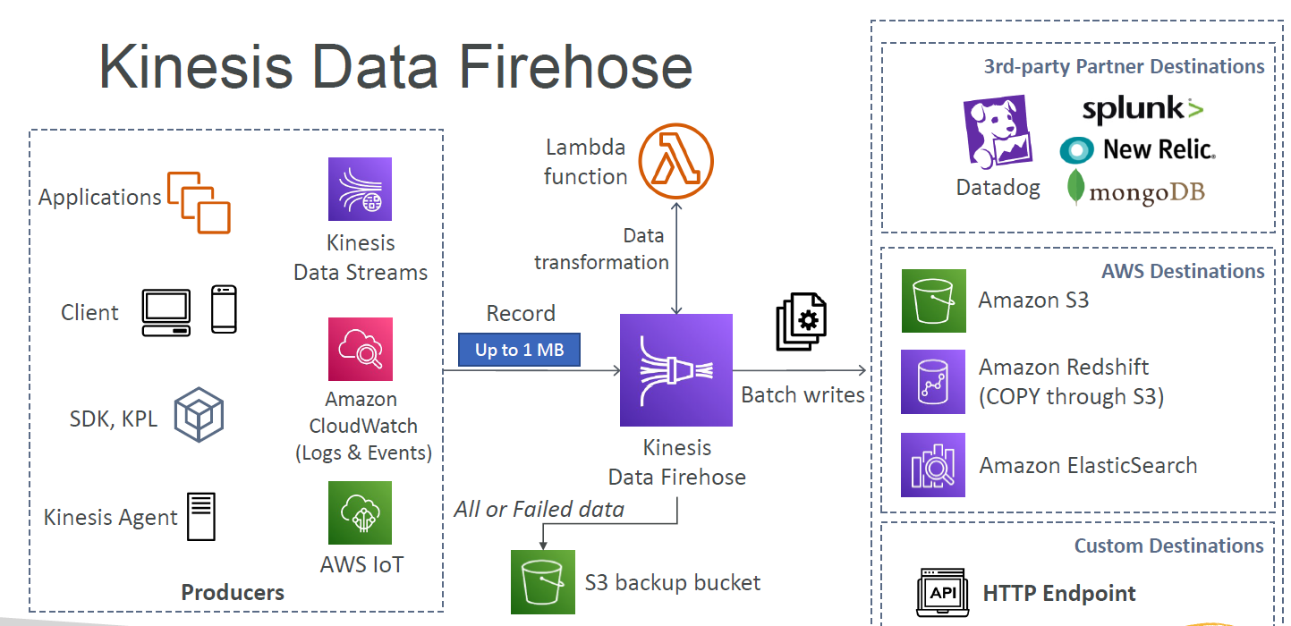

Slide 23
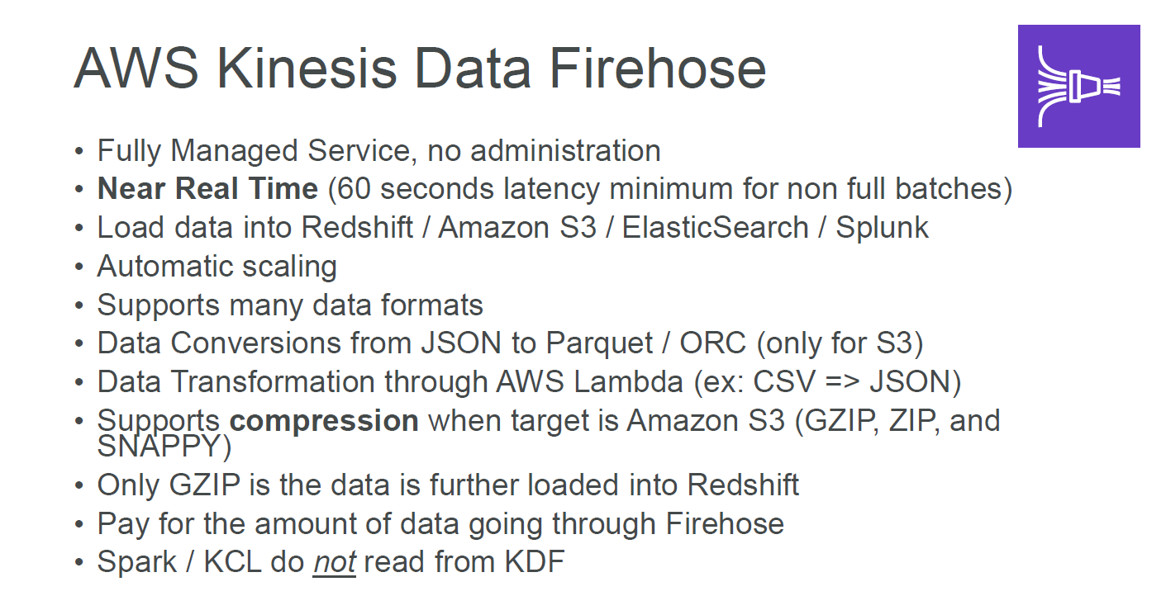

Slide 24

AWS LAMBDA

Slide 25
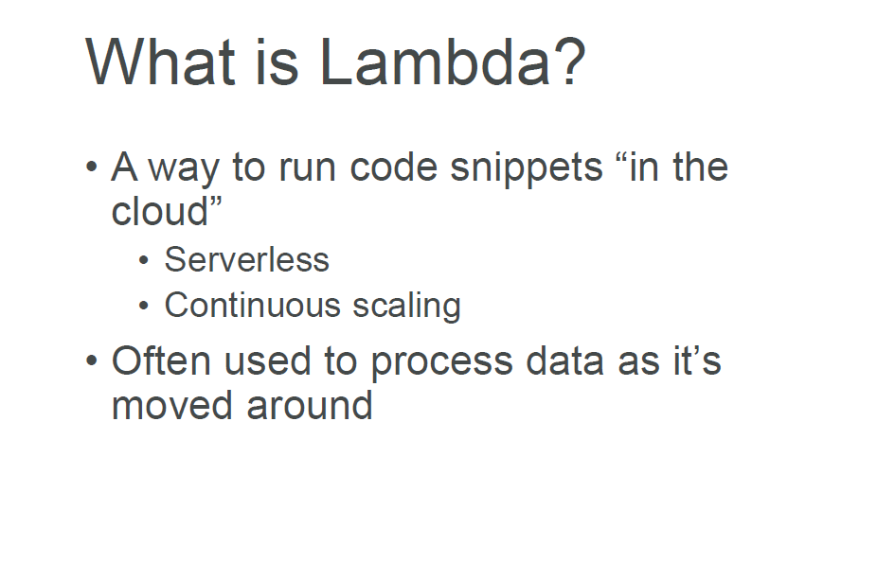

Slide 26
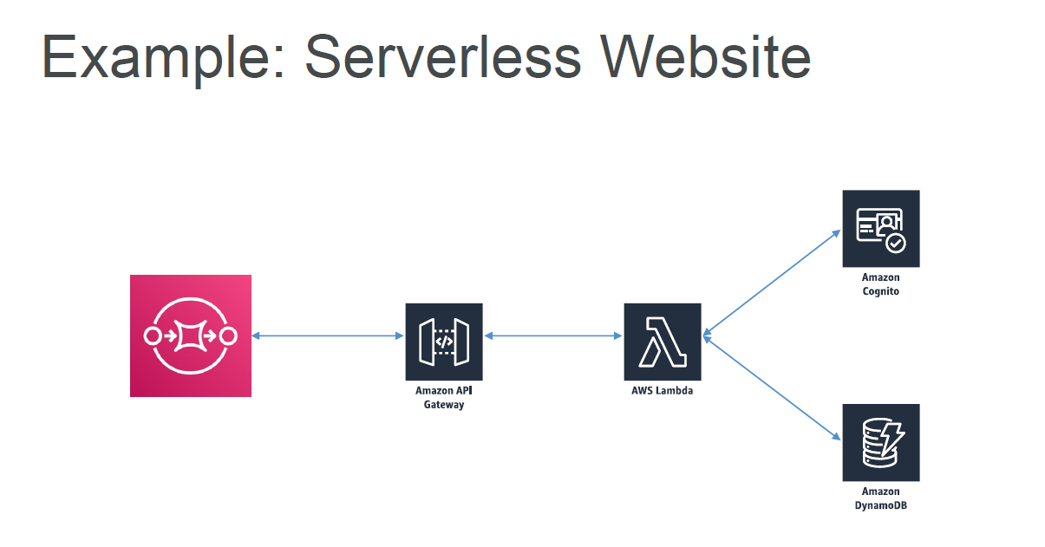

Slide 27
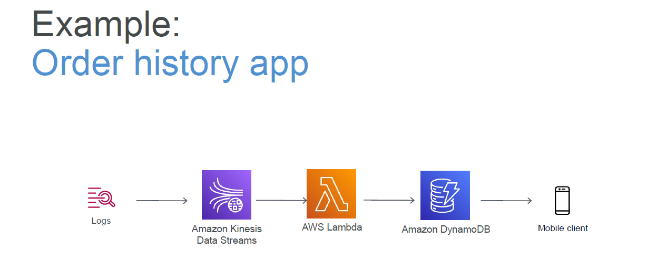

Slide 28
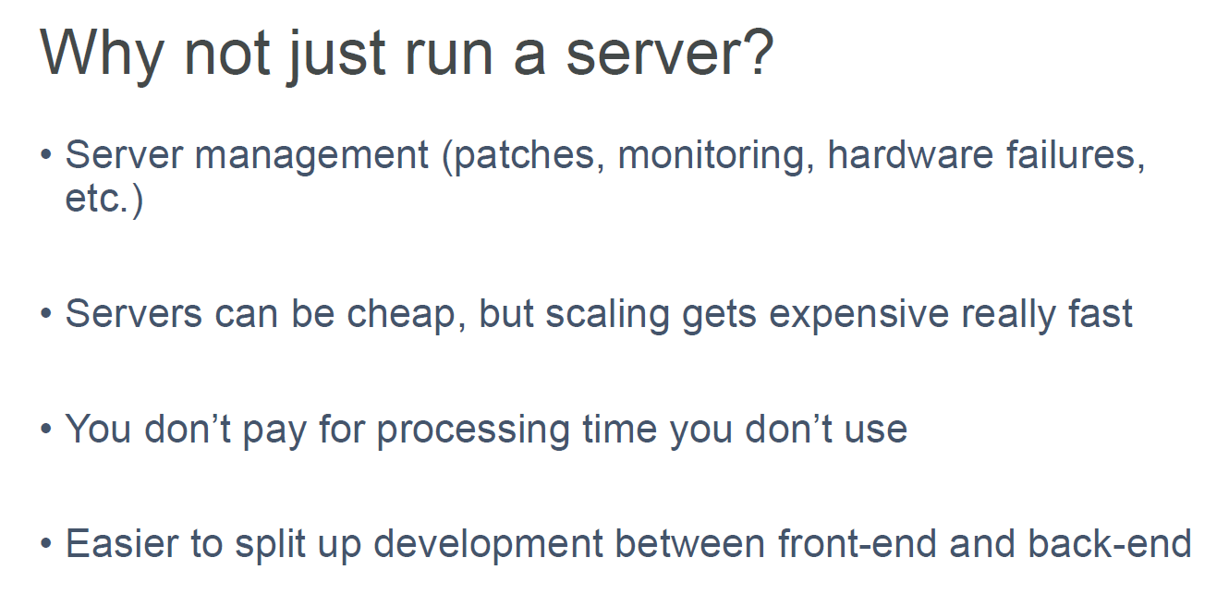

Slide 29
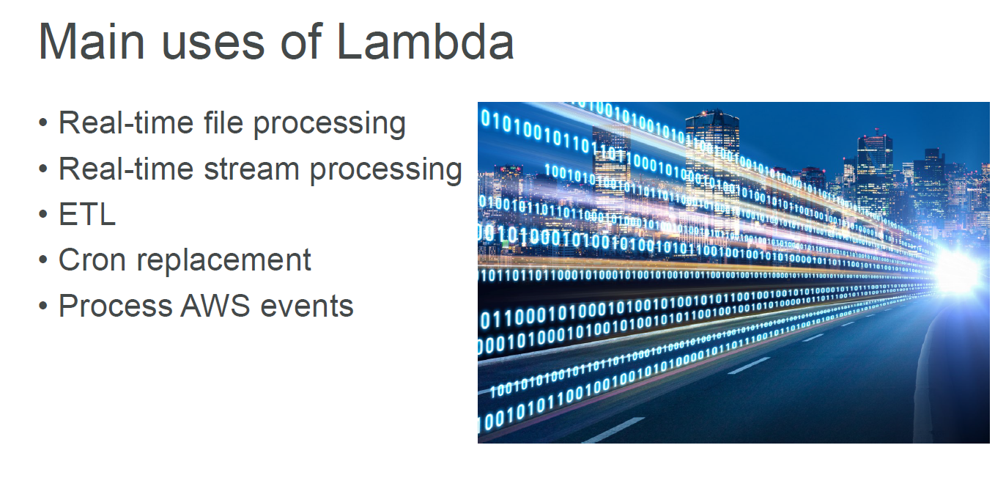

Slide 30
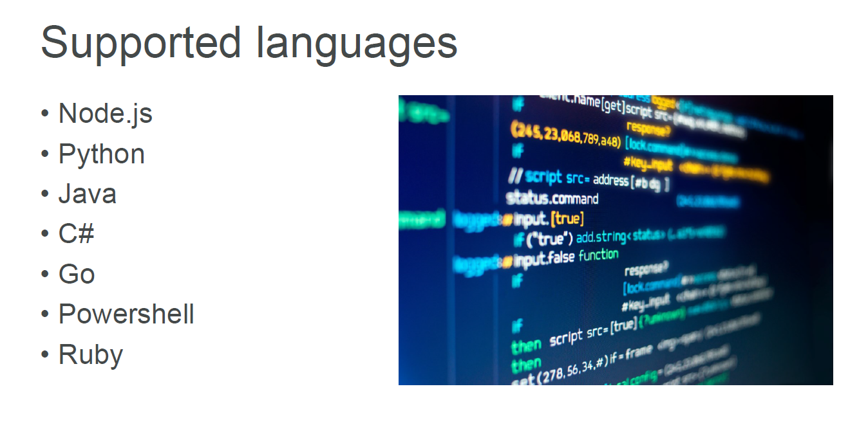

Slide 31
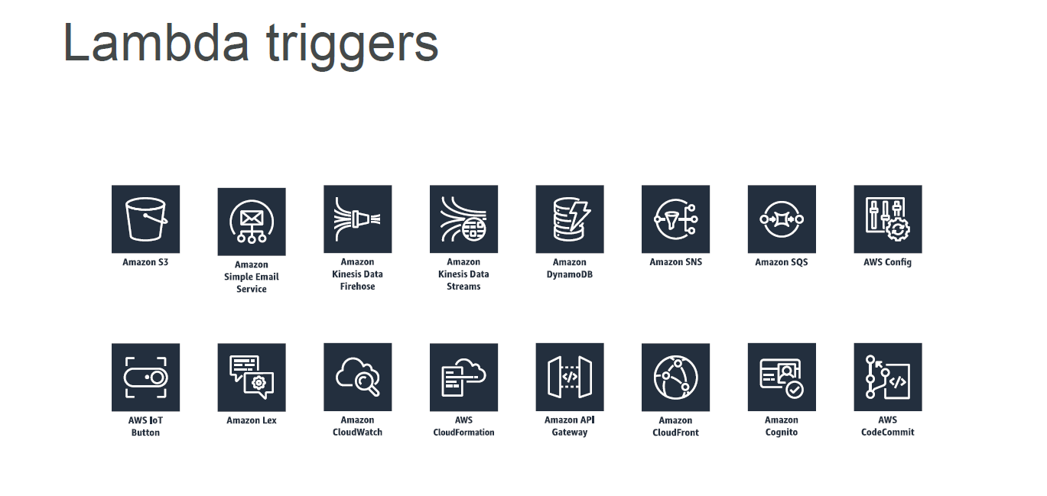

Slide 32
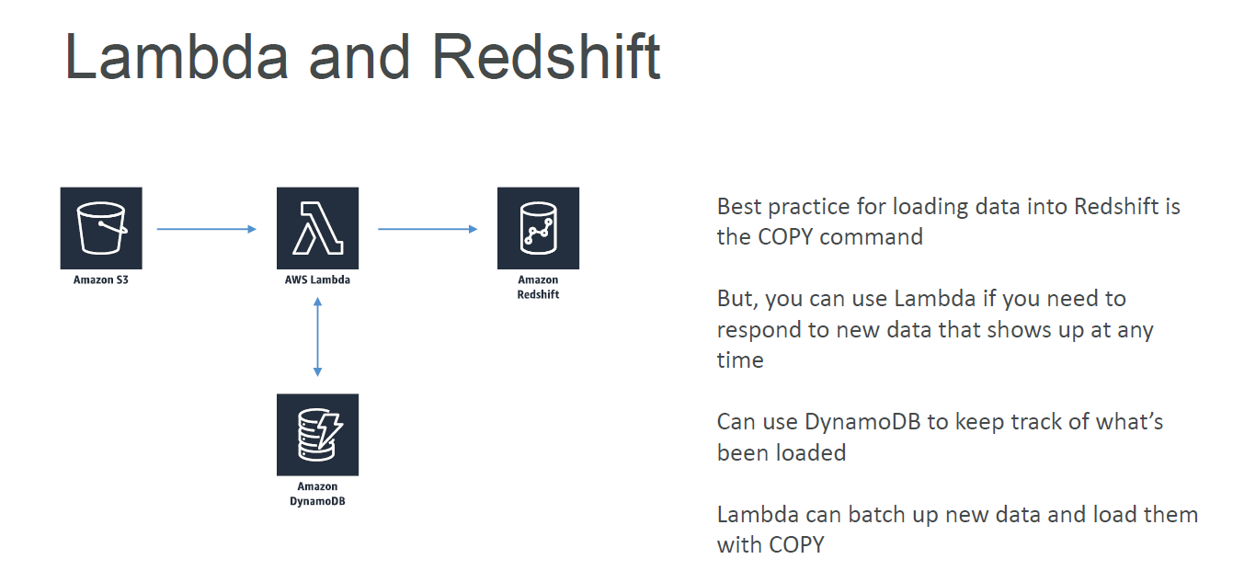

Slide 33
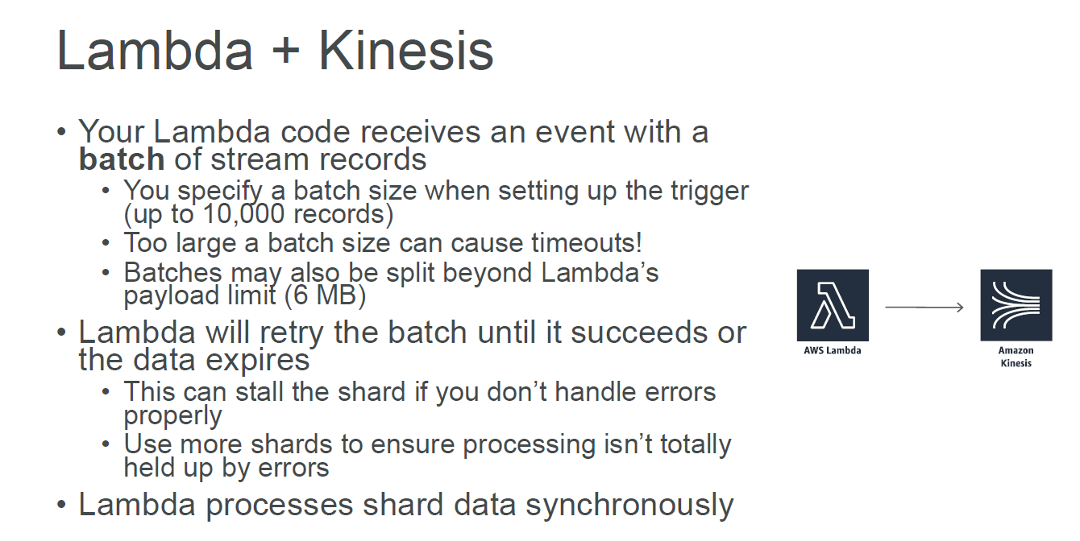

Slide 34

AWS GLUE

Slide 35
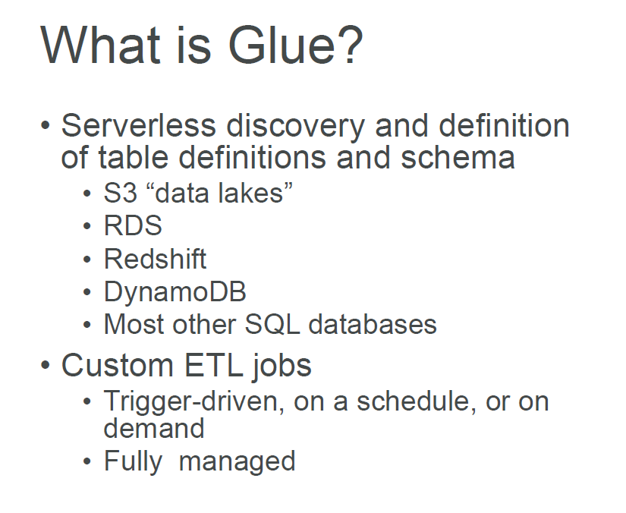

Slide 36
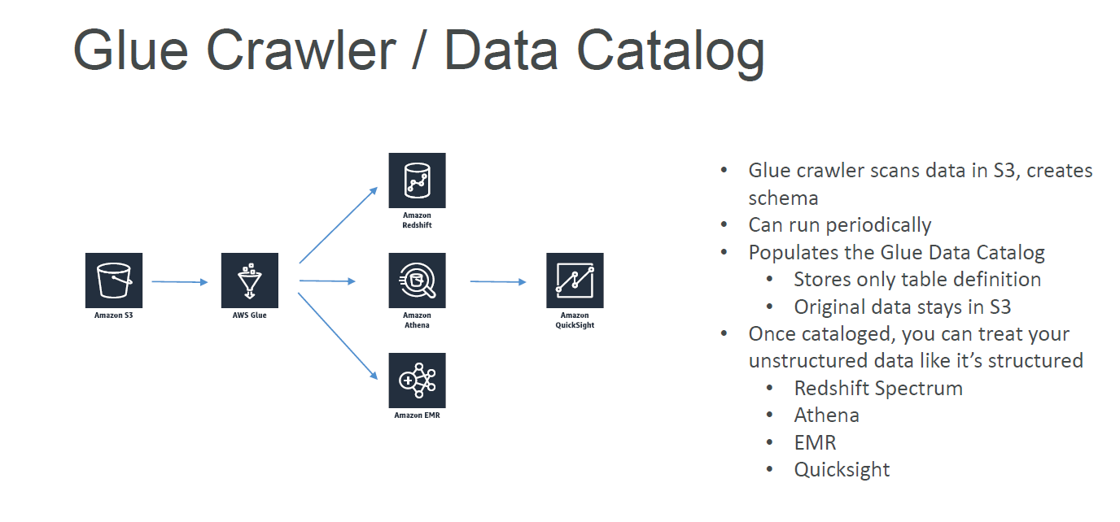

Slide 37
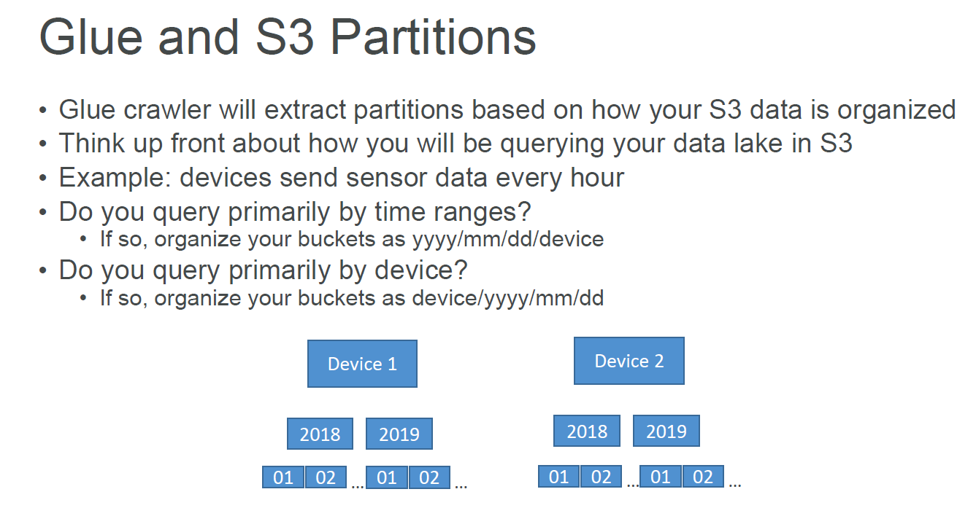

Slide 38
GLUE Components
Data catalog: The data catalog holds the metadata and the structure of the data.
Database: It is used to create or access the database for the sources and targets.
Table: Create one or more tables in the database that can be used by the source and target.
Crawler and Classifier: A crawler is used to retrieve data from the source using built-in or custom classifiers. It creates/uses metadata tables that are pre-defined in the data catalog.
Job: A job is business logic that carries out an ETL task. Internally, Apache Spark with python or scala language writes this business logic.
Trigger: A trigger starts the ETL job execution on-demand or at a specific time.
Development endpoint: It creates a development environment where the ETL job script can be tested, developed, and debugged.

Slide 39
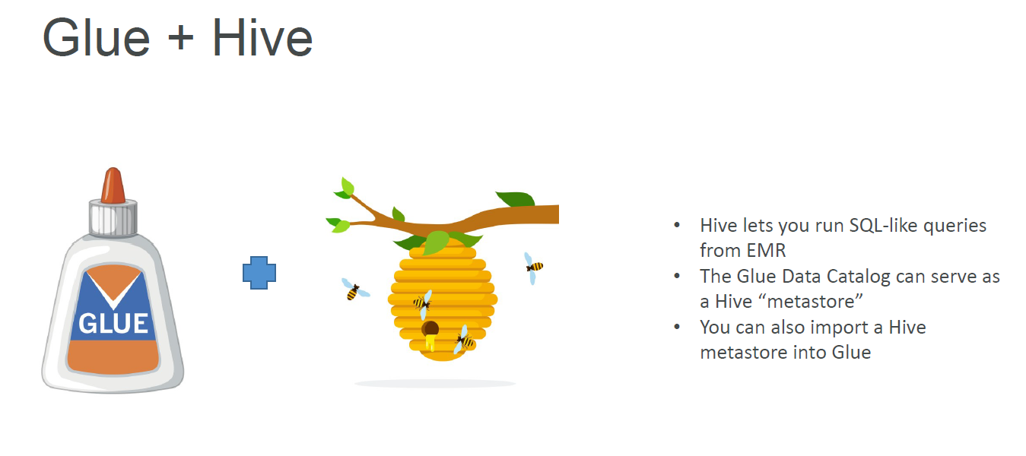

Slide 40
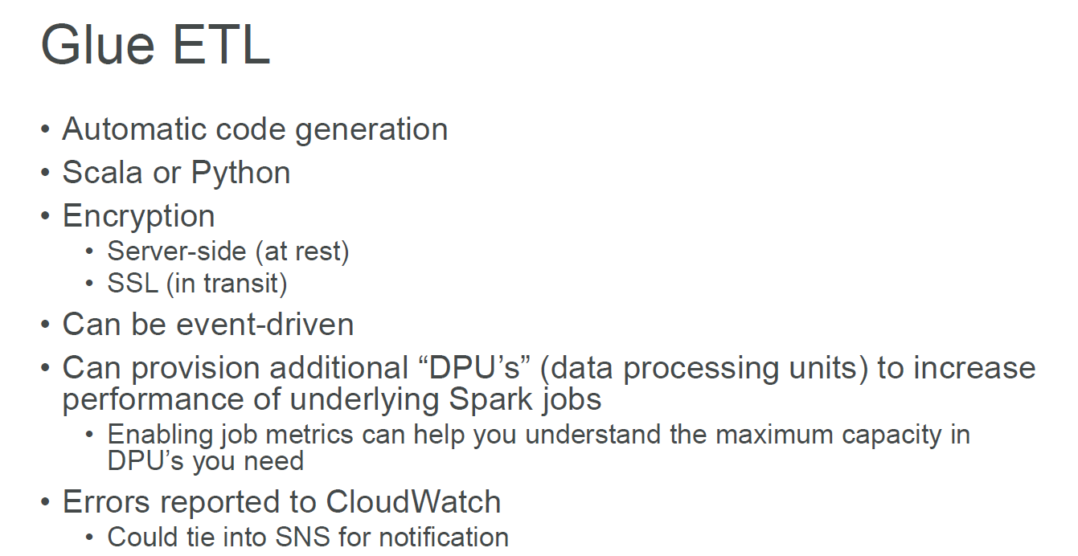

Slide 41
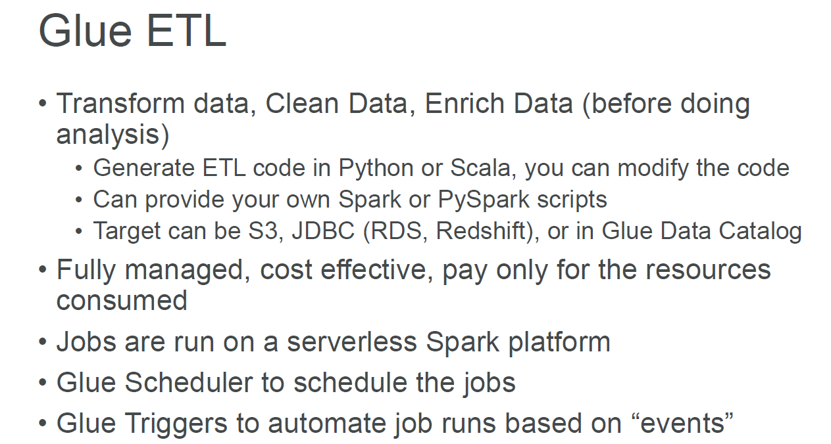

Slide 42
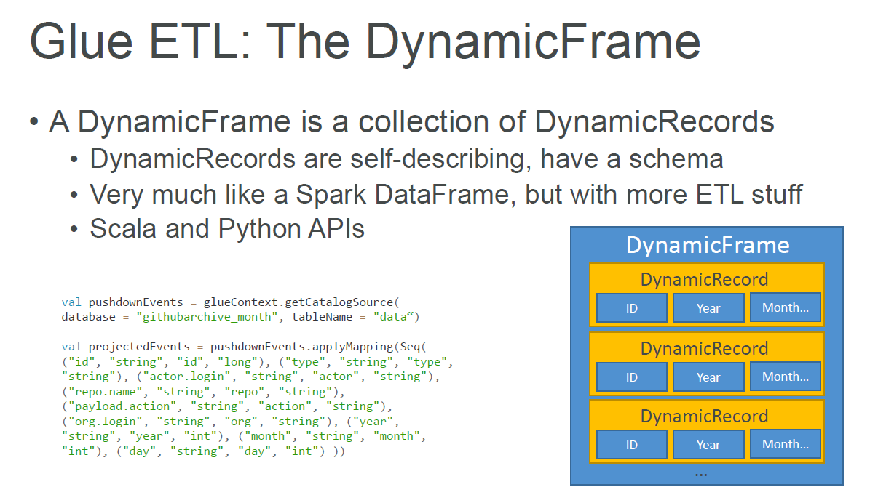

Slide 43
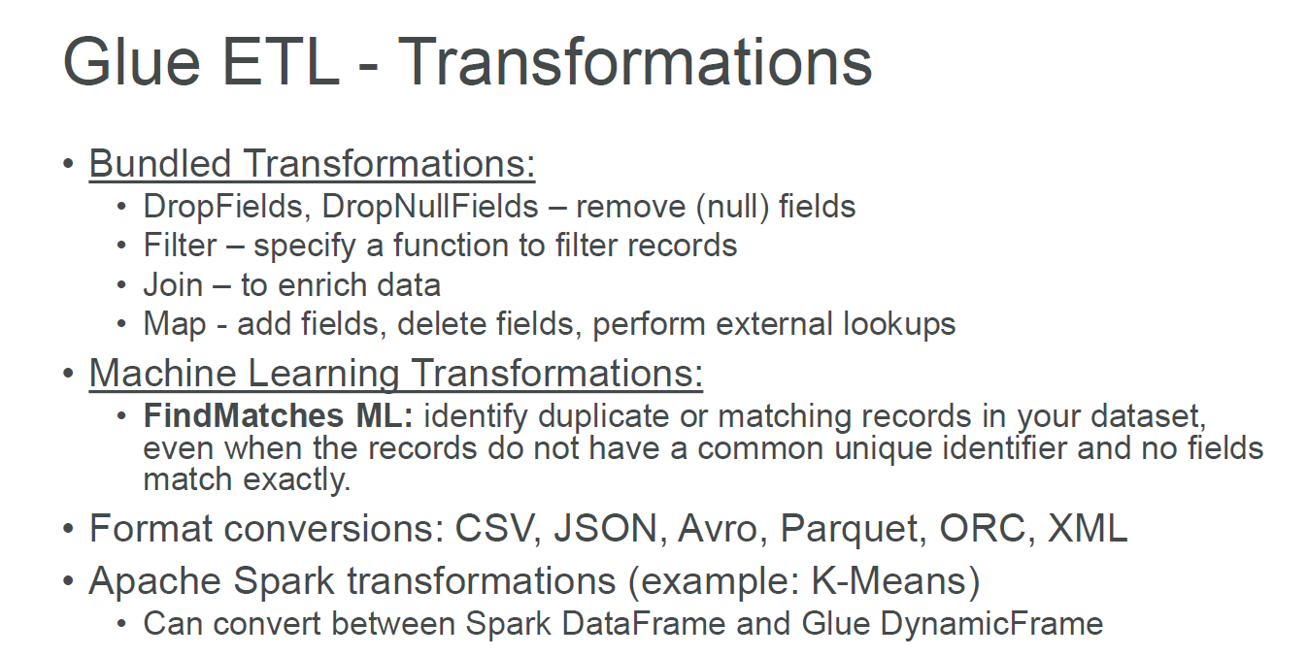

Slide 44
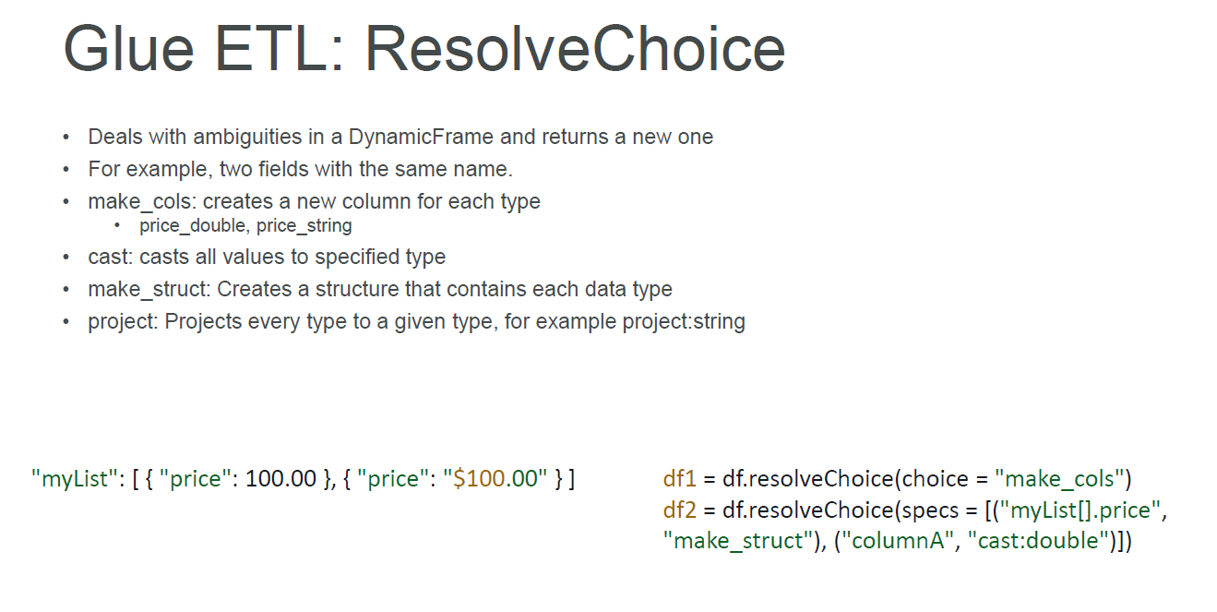

Slide 45
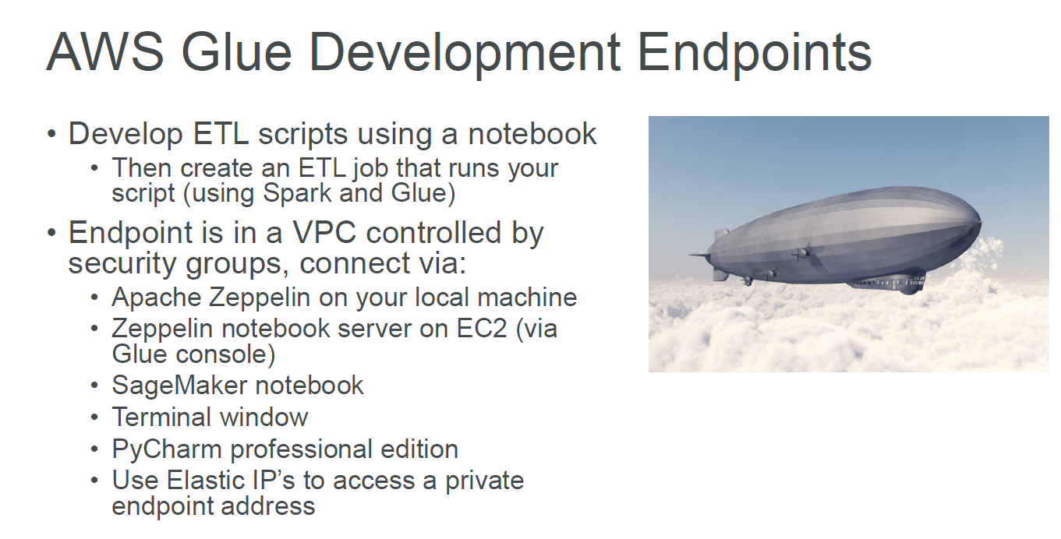

Slide 46
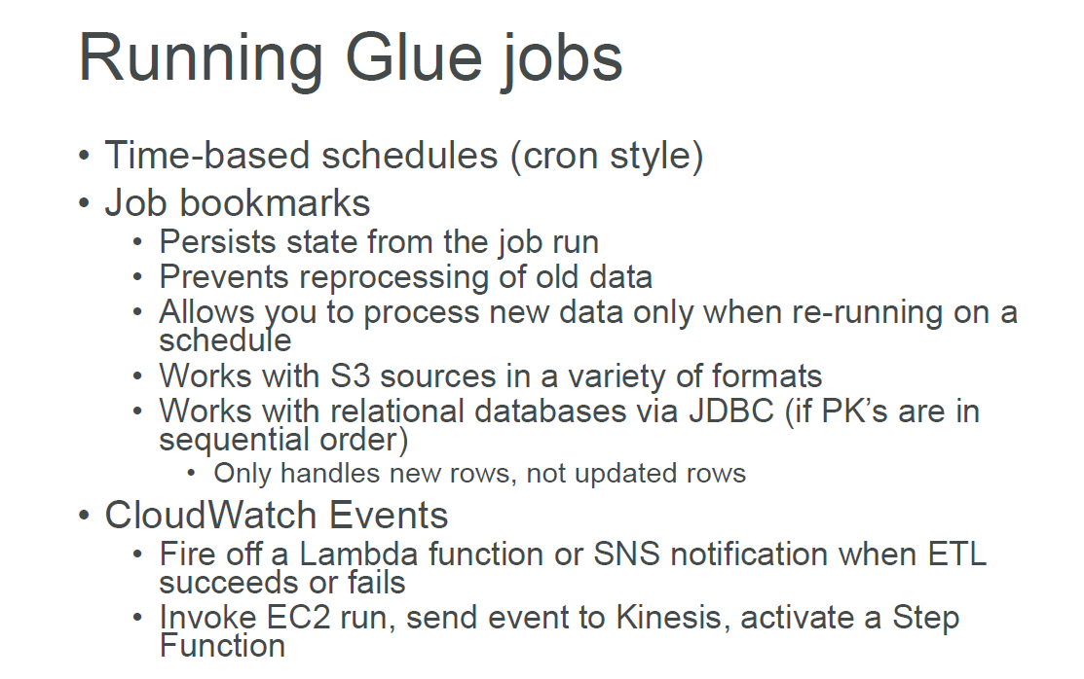

Slide 47
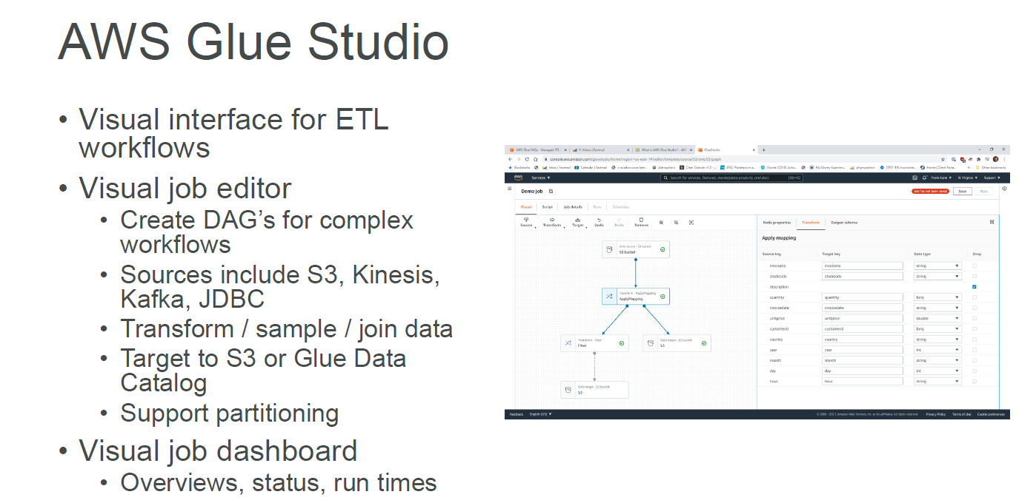

Slide 48
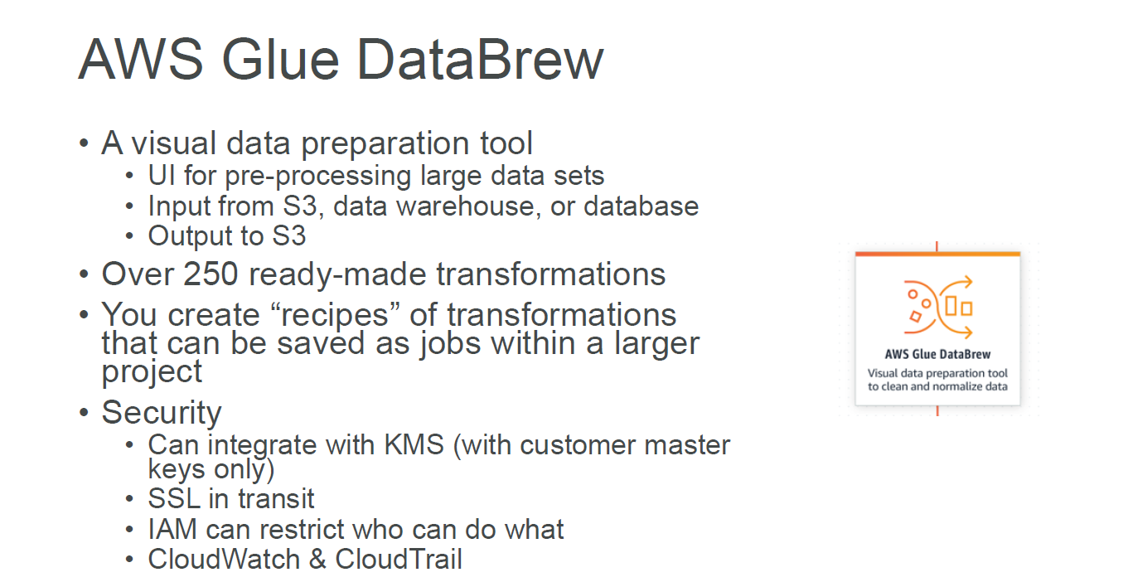

Slide 49
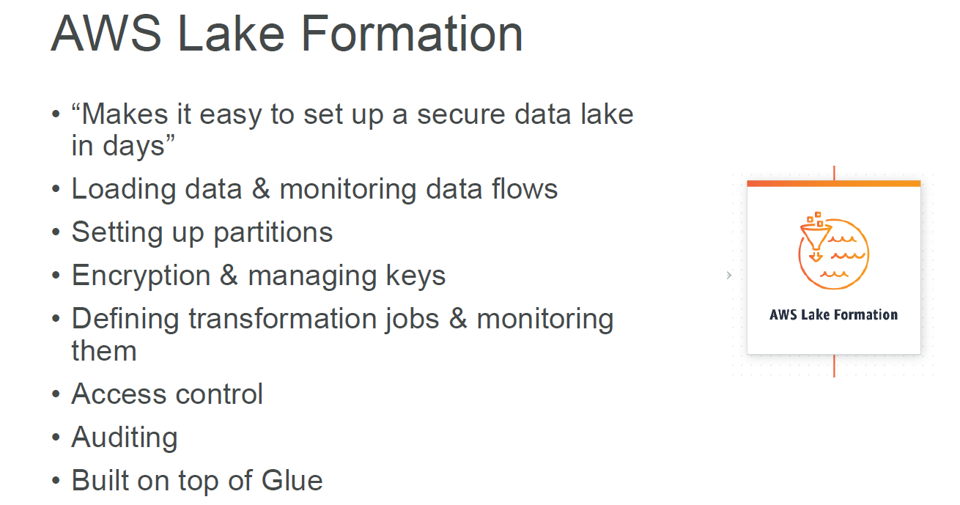

Slide 50

Amazon Redshift

Slide 51
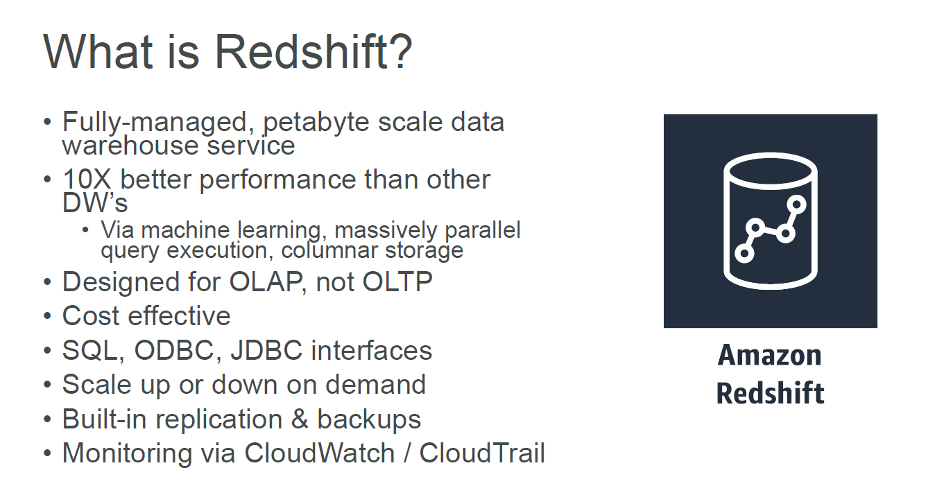

Slide 52
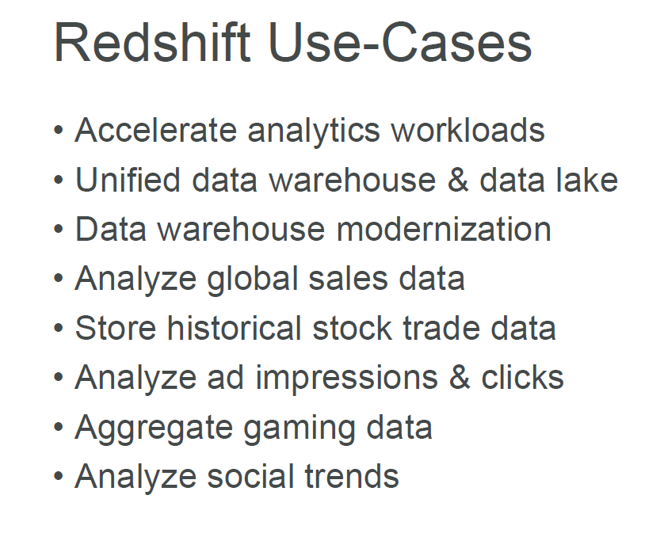

Slide 53
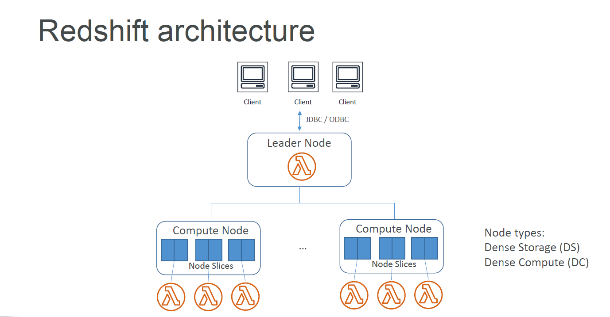

Slide 54
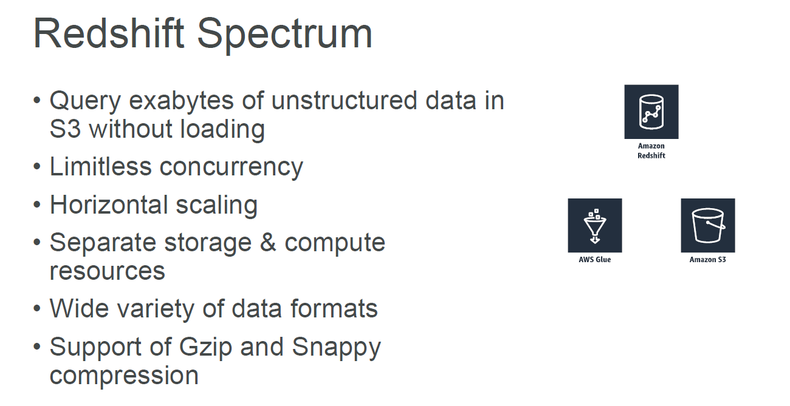

Slide 55
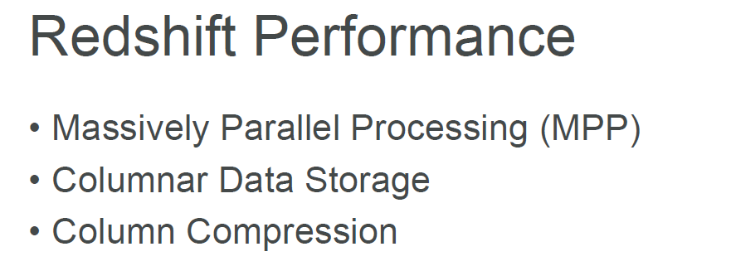

Slide 56
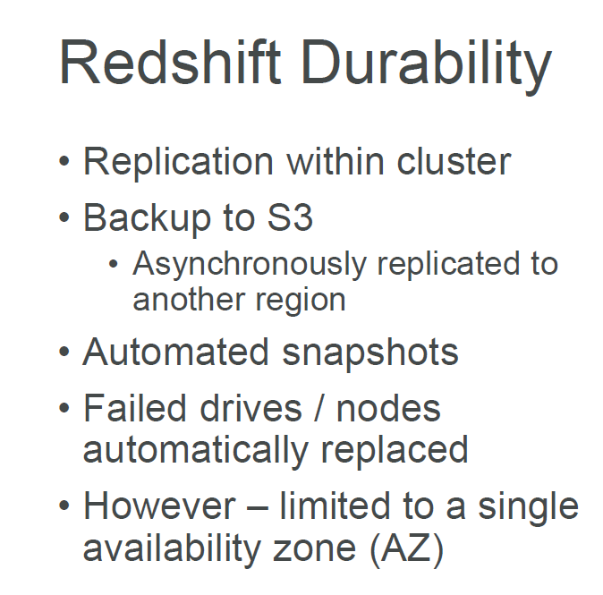

Slide 57
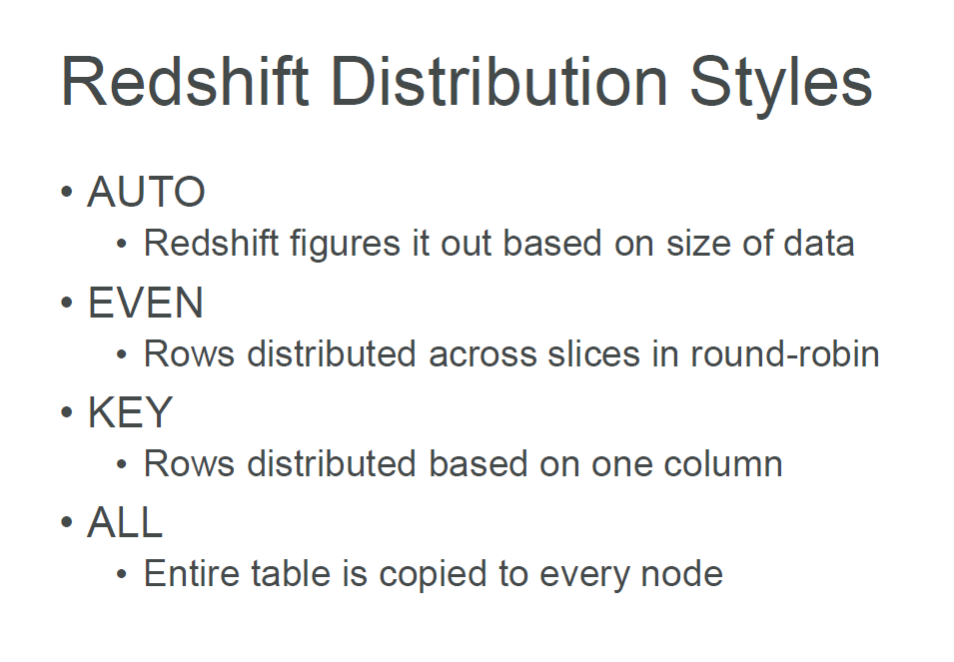

Slide 58
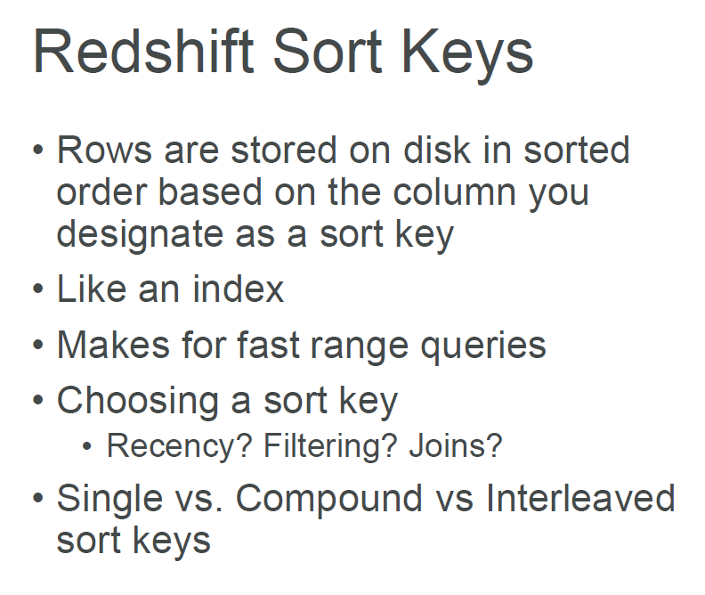

Slide 59
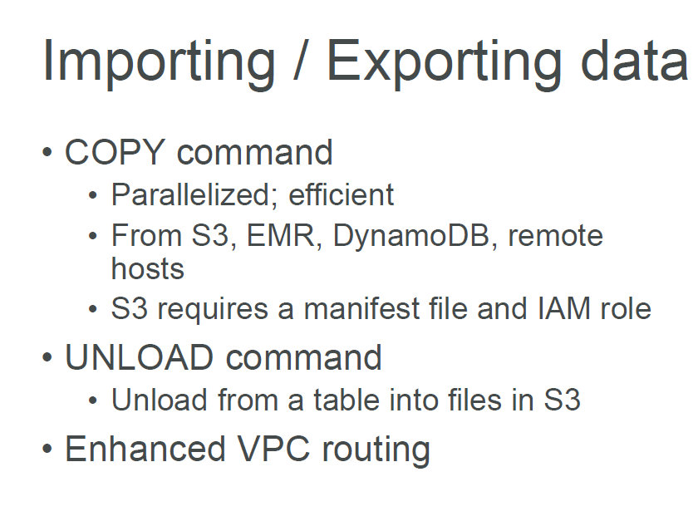

Slide 60


